Slide 1
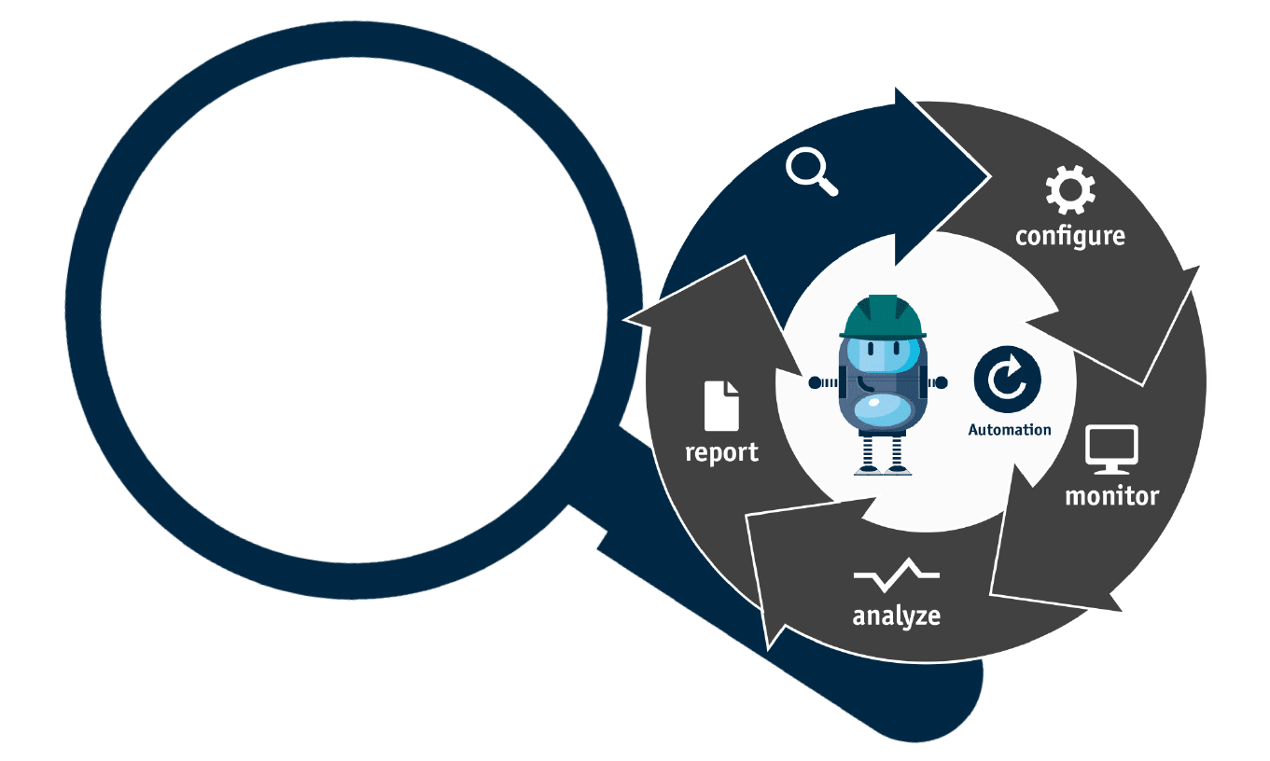
OSC
Automation Tool
We provide a set of testing automation activities within this tool including, 2G/3G Controllers Regression, SRAT and SRAN BTSs Regressions, System Configurations, KPIs Analysis, etc..
This tool is still under development ☺
test
Skill Center

